Slide 1


Affirma Consulting | Case Studies
Microsoft:
Videos, Webinars and Webcasts

Slide 2

Case Study: Azure Webinar Series
Program Summary:
The Azure webinar series includes 10+ monthly webinars with topics spanning the breadth of Azure products and services.
These webinars support the Azure Global Engagement Programs (GEPs) and are designed to: drive engagement with known leads and move customers through the funnel, contributing to down funnel outcomes.
This program currently includes 10 GEPs and typical monthly execution of 8-12 webinars.
Webinar
Execution
Webinars completed
Audience Satisfaction
Monthly webinars are pre-recorded, edited and closed captioned by the Affirma team. Final execution is a simulated live broadcast with live in console Q&A.
Attendees responding to the survey provided in the webinar console indicate an 87% average satisfaction rate with the webinar content.
150+ webinars completed in FY18 and FY19 to date. The program averaged 9 webinars per month across a total of 10 GEPs.
.
The participants attending Azure webinar series events have a high level of audience engagement which is measured by the following statistics:
44,000+ unique clicks to resources provided on the webinar console, effectively moving customers through the funnel
13,000+ survey responses submitted
9,000+ questions asked
Average live duration: 53 minutes (average webinar is 60 minutes)
Notes:
References:
https://blog.hubspot.com/marketing/video-marketing-statistics
https://www.forbes.com/sites/forbesagencycouncil/2017/02/03/video-marketing-the-future-of-content-marketing/#193a1ff06b53
https://contentmarketinginstitute.com/2017/10/video-content-investment/
http://www.marketwired.com/press-release/a-minute-of-video-is-worth-18-million-words-according-to-forrester-research-1900666.htm

Slide 3
Case Study: Getting Started with Azure Live Demo (FY17 – FY20)
Program History and Impact:
Affirma was hired to assist in the development, planning and execution of the initial Getting Started pilot program. The goal of the pilot was to determine if attendance at a live Getting Started live webinar would lead to a positive impact on conversion from trial. Affirma has been managing the deployment of a now mature program used to drive over 20,000 live attendees in the past two fiscal years.
A positive impact on conversion from trial was proven in the initial pilot based on data comparing the webinar attendees to the control group.
Affirma has continued to manage and develop program improvements in FY18 and FY19 including the addition of on demand localized version. Affirma has worked closely with the SME to coordinate content iterations to ensure content is reflective of the current Azure experience.
FY17 Pilot
Affirma was hired to help deploy and manage the pilot of this program in FY17 including A/B testing and business impact evaluation measured by conversion from trial and consumption.
Program engagement
90% program satisfaction - highly satisfied or satisfied
Program attendees have shown a high level of engagement with the content indicted by the following statistics:
15k+ unique clicks to resources
5.5k+ poll responses
6.5k+ questions asked
.
he initial pilot program with X outcomes ling and execution of the initial pilot program with X outcomes leading the deployment of a now mature program used to drive XXX
Program volume
Programmatic improvements
150+ live webinars have been delivered from March of FY17 to date.
Additional program stats include:
138k+ registrations
21k+ attendees
Self-serve on demand version now available
Localized version in multiple languages
Updates to resources, surveys and polls to draw critical analytics
Live closed captioning
Iterations on CTAs and improved program access
Notes:
References:
https://blog.hubspot.com/marketing/video-marketing-statistics
https://www.forbes.com/sites/forbesagencycouncil/2017/02/03/video-marketing-the-future-of-content-marketing/#193a1ff06b53
https://contentmarketinginstitute.com/2017/10/video-content-investment/
http://www.marketwired.com/press-release/a-minute-of-video-is-worth-18-million-words-according-to-forrester-research-1900666.htm

Slide 4
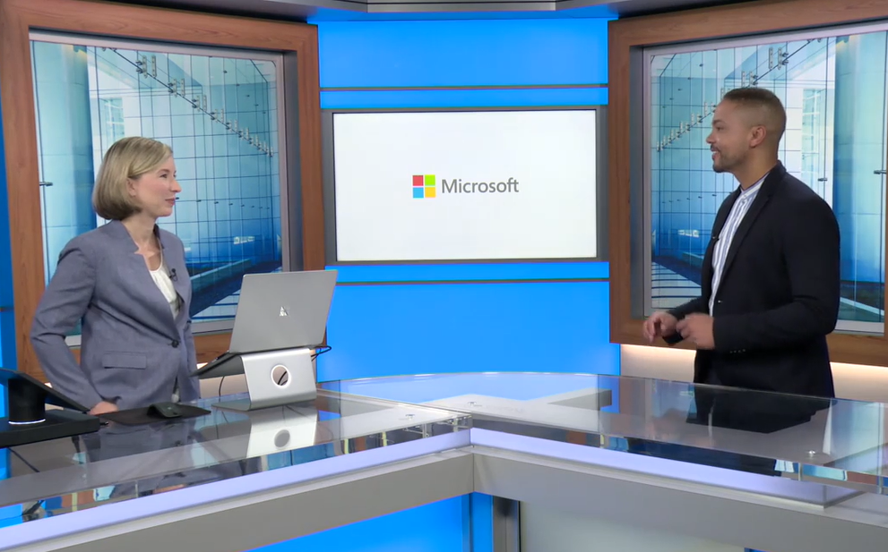
Case Study: Modern Workplace GEP Webcast Program
Program Summary:
The Modern Workplace webcast program offers Global Engagement Programs the opportunity to develop on-demand, studio produced webcasts.
The webcasts are utilized in a variety of ways which may include use as a touch in the nurture stream or acquisition of new leads.
Affirma has managed 7 webcasts across the Modern Workplace GEPs in FY18/19.
Project Management and Microsoft Studios Production
Affirma works in conjunction with the Modern Workplace content team, GEP leadership and the production team to develop and manage the workback schedule and end to end production of the webcasts which are recorded at Microsoft Studios.
Webcast Project Management includes support and end to end management of the webcast process including:
Development and management of workback schedules
Coordination with BPMs and MOPS to ensure webinar build and promotional processes are in place: emails, blogs, social
Scheduling of all team meetings
Coordination of script development
GCS and AEM process management
Reporting and analytics to identify opportunities and provide insights

Slide 5
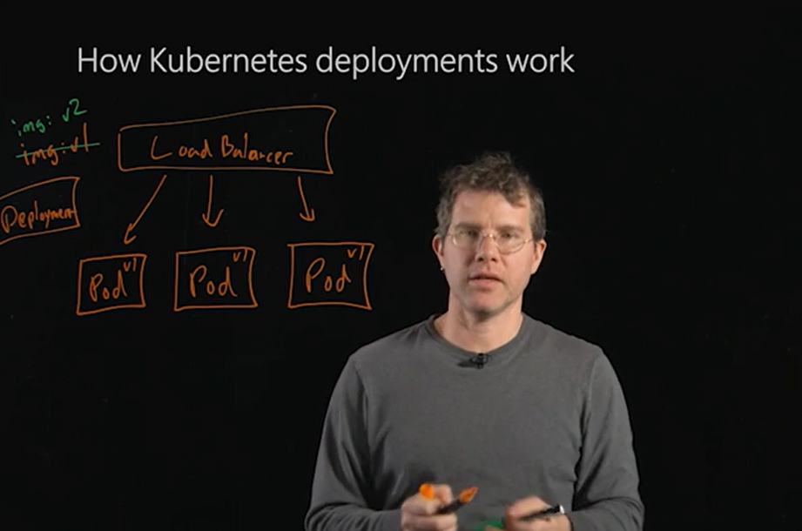


Webinar Production Options:
Affirma offers expertise in a wide variety of video and webinar production options including:
Microsoft Studios productions including, voice overs, demos, lightboard demos and on camera webinars
Standard voice over PowerPoint on demand webinars with or without demos.
These webinars are produced using the ON24 webinar platform and are not studios produced.

Slide 6

Affirma Benefits & Team Overview

Slide 7
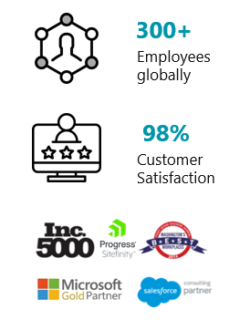
Affirma Locations
OUR MISSION
“Become the best at applying solutions and services to positively impact people.”
Dublin, Ireland
Bellevue, WA
Reno, NV
Ahmedabad, India
Los Angeles, CA

Slide 8
Affirma and Microsoft
Affirma is all-in on Microsoft as a supplier, Gold Certified Partner, and end user. Below is information around our relationship in each of those areas.
Supplier:
Affirma is projected to do nearly 20M in revenue as a supplier to Microsoft across the organization. We work in a number of different organizations including the GDC, Microsoft Operations, XBOX, CSS, Services, Marketing and Finance.
Partner:
Microsoft is a Gold Certified (multiple competencies) and Managed Partner. We are also a Tier1 CSP partner. We sell Microsoft technology solutions into hundreds of companies nation-wide. We have influenced many millions of dollars of software deals and work very closely with the Microsoft account teams on the West coast. We are a highly valued and trusted SI partner focusing on delivering Office365 (Exchange, Skype, SharePoint, Teams), Azure, CRM, SQL Server, PowerBI, Windows and other technology solutions for our clients.
End User:
Affirma has consolidated all of our technology on the Microsoft platform. We use Office365 for email, SharePoint, Skype, Teams. We use Dynamics CRM for our CRM platform and leverage Azure to host our development servers and those for our clients as well.
Affirma and Microsoft Relationship

Slide 9

Affirma Program Management Practices
Operational rigor and quick response times
Commitment to understanding and implementing programs based on client goals
Adherence to proven programmatic workback schedules
Ability to provide granular cost alignment
Program Execution
Program management adhering to aligned upon program workback schedule
Monthly, Quarterly and Annual program planning with stakeholder teams
Partnership with stakeholders including weekly status reports
Development of real time program self serve status dashboards and reporting tools
Adherence to brand guidelines and accessibility requirements
Implementing best practices and providing program improvement recommendations
Providing detailed and current reporting and analytics
Providing actionable insights based on analytics and data
A/B Testing and analysis
Standards of Practice
Reporting, Improvements & Iterations
Stakeholder interviews
Analytics reviews
Competitive reviews
Goal setting
Research & Planning
Notes:
References:
https://blog.hubspot.com/marketing/video-marketing-statistics
https://www.forbes.com/sites/forbesagencycouncil/2017/02/03/video-marketing-the-future-of-content-marketing/#193a1ff06b53
https://contentmarketinginstitute.com/2017/10/video-content-investment/
http://www.marketwired.com/press-release/a-minute-of-video-is-worth-18-million-words-according-to-forrester-research-1900666.htm

